Slide 1
Kratos
StructuralMechanics
interface
Vicente Mataix Ferrándiz
Kratos Workshop - 2018

Slide 2
Index
Main overview
Analysis available
Elements available
Conditions available
Solution and post-process options
Feedback
Kratos Workshop - 2018

Slide 3
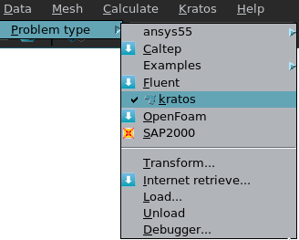
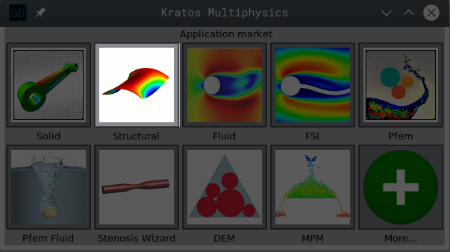
Main overview
First we chose the Structural application on Gid Interface menu:
We go to Data Problem type kratos
We need to install first the problem type of course
Kratos Workshop - 2018

Slide 4

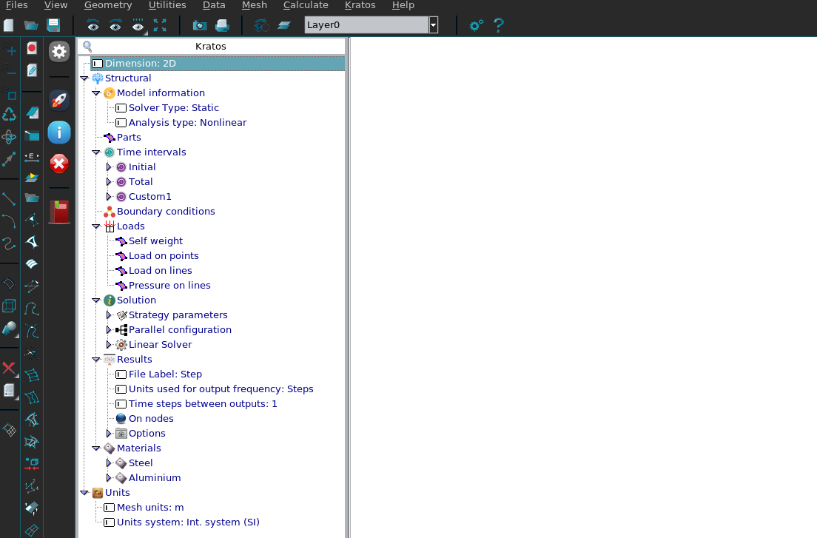
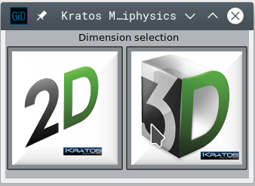
Main overview
The interface will look something similar to the following:
Select dimension
Avalaible analysis
Definition of the elements
Time intervals
Boundary conditions definition
Loads definition
Definition of solvers and other solution parameters
Definition of the output solution
Definition of materials
Kratos Workshop - 2018

Slide 5
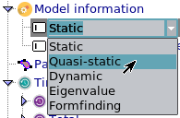
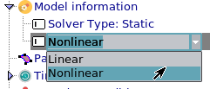
Analysis available
The interface offers the following analysis options:
Static
This is the most basic analysis, for simple static analysis
Quasi-static
Similar to the previous one, but allows consider time evolution loads
Dynamic
For pure dynamic problems
Eigenvalue
This analysis aims to compute the eigenvalues of an structure. Right now only supports modal analysis
Formfinding (developer)
This analysis aims to get the best shape for a pre-stressed membrane for a given load combination
Analysis can be linear or non-linear
Kratos Workshop - 2018

Slide 6


Elements available
The interface offers the following elements:
Solid elements:
Small displacement element
Small displacement element Bbar (just quad)
Total lagrangian element
Updated lagrangian element
Slender elements:
Beam small displacement
Beam large displacement
Truss small displacement
Truss large displacement
Pre-stressed cable
Available constitutive-laws:
Linear elastic plain strain
Linear J2 plasticity plain strain
Hyperelastic Neo-Hookean plain strain
Hyperelastic Kirchoff Saint-Venant plain strain
Solid elements:
Small displacement element
Small displacement element Bbar (just hexa)
Total lagrangian element
Updated lagrangian element
Slender elements:
Beam small displacement
Beam large displacement
Truss small displacement
Truss large displacement
Pre-stressed cable
Pre-stresed membrane (developer)
Co-rotational thin shell
Co-rtotational thick shell
Available constitutive-laws:
Linear elastic 3D/plain stress
Linear J2 plasticity 3D/plain stress
Hyperelastic Neo-Hookean 3D/plain stres
Hyperelastic Kirchoff Saint-Venant 3D
Kratos Workshop - 2018

Slide 7
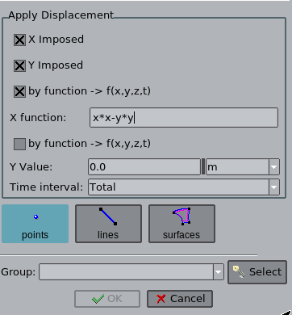
Conditions available
The interface offers the following boundary conditions:
Solid elements:
Displacements
Velocities (dynamic)
Accelerations (dynamic)
Contact (developer)
Slender elements:
Displacements
Velocities (dynamic)
Accelerations (dynamic)
Contact (shells/developer)
Rotation (shell/beam elements)
Angular velocities (shell/beam elements in dynamic)
Angular accelerations (shell/beam elements in dynamic)
Hinges (beams/truss elements)
BC can be set by functions
Kratos Workshop - 2018

Slide 8
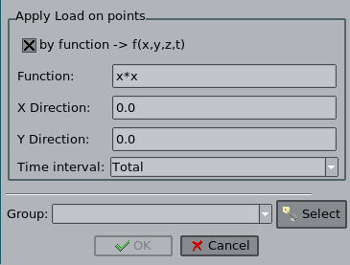
Conditions available
The interface offers the following load conditions:
2D
Self weight
Load on points
Load on lines
Pressure on lines
3D
Self weight
Load on points
Moment on points
Load on surfaces
Pressure on surfaces
Load conditions can be se by functions
Kratos Workshop - 2018

Slide 9
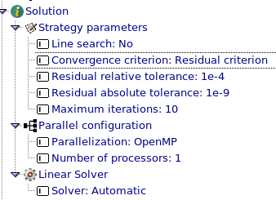
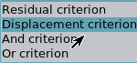
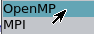
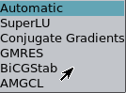
Solution/post-process options
We can configure the following parameters for the solution:
Kratos Workshop - 2018

Slide 10
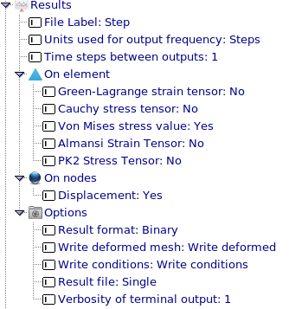
Solution/post-process options
We can configure the following parameters for the post-process:
Remember to generate mesh (Ctrl+G) and sabe before running simulation (F5)
Output frequency
Output results (depend on the elements assigned)
Output format
Kratos Workshop - 2018

Slide 11
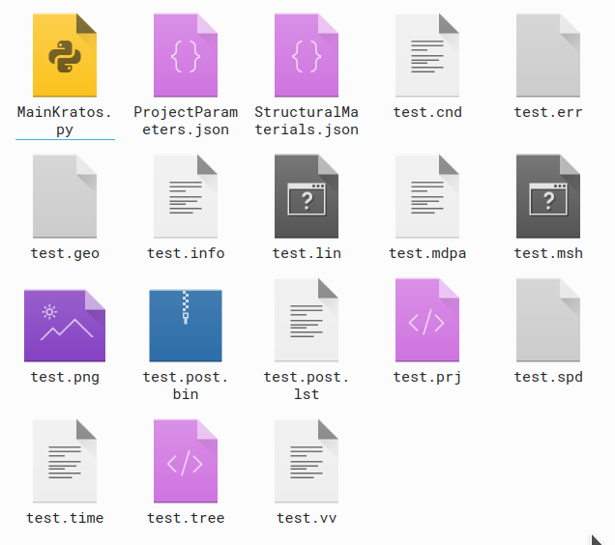
Solution/post-process options
After running (F5) we get the following files:
MainKratos.py
Main script that calls the Kratos routines
ProjectParameters.json
File containing the BC, loads and configurations of the simulation
StructuralMaterials.json
File that contains the definition of the materials and CLs
test.mdpa
File containing the mesh, with the elements, conditions, nodes, submodelparts…
test.post.bin
Resulting file which contains the results
Kratos Workshop - 2018

Slide 12
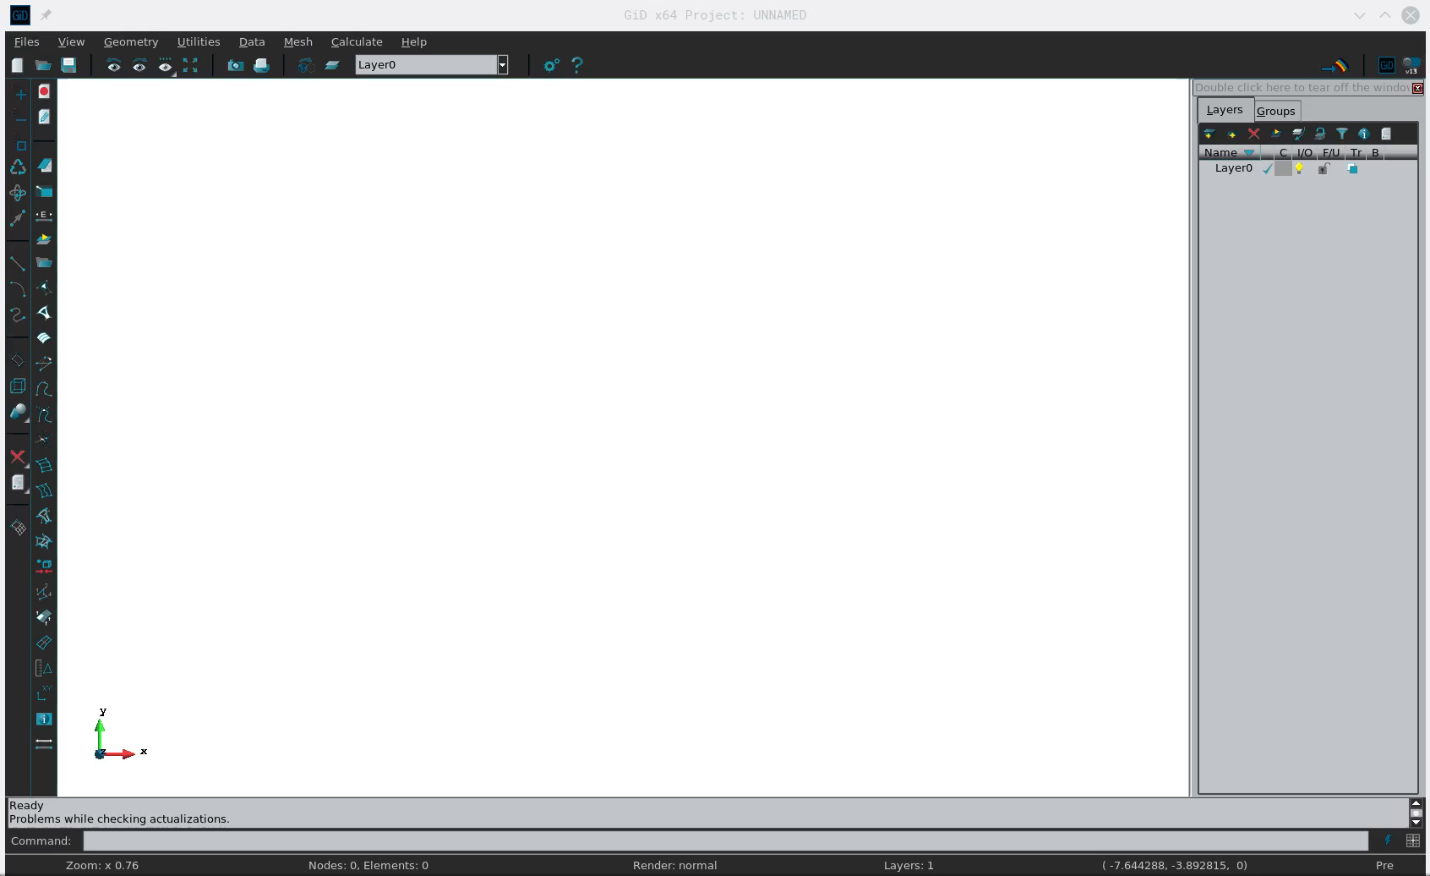
Example
11
Kratos Workshop - 2018

Slide 13

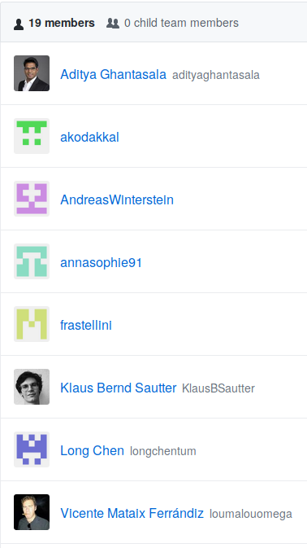
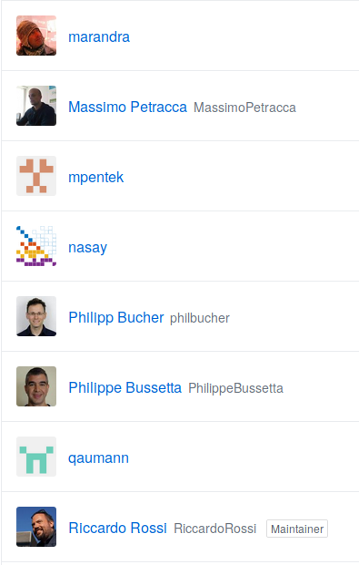
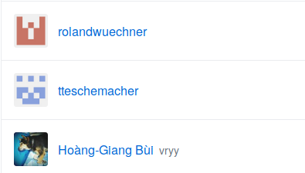
Extra: StructuralMechanics development
12
Kratos Workshop - 2018

Slide 14
Thank you very much for your attention!!
Feedback
Any suggestion to imporve the interface?
Please contact us on the GitHub community (https://github.com/KratosMultiphysics/GiDInterface)

